Slide 1
THIS IS YOUR PRESENTATION TITLE
Rachel Z. Insler
Capstone Project Presentation
DSIR – 22221E
May 13, 2021

Slide 2
Clear communication should always be a goal in science. It’s important to step back and always remind yourself as a scientist:
how do I describe what I’m doing to someone who is not doing this 24/7 like I am?”
-Sabine Stanley, planetary scientist at Johns Hopkins University
The New York Times, Trilobites Column; April 9, 2021
Notes:
Really got me thinking – background as an academic researcher, communications professional

Slide 3
BACKGROUND
As data scientists, our ability to transform information into actionable insights can have a profound impact on the organizations we support.
But if no one understands what we are talking about…our influence will be severely limited.

Slide 4
BACKGROUND
A recent exploration into the literature surrounding cave science found that research papers containing lots of specialized terminology are less likely to be cited by other researchers.
Does that finding hold for the highly technical field of machine learning?
Notes:
So this new York times article referenced a recent …
Citations are important for a few reasons. Some of them, like career advancement and tenure evaluation, are outside the scope of this discussion.
But at the most basic level – the more times your paper is cited, the greater reach it has, more people are exposed to your ideas and research. If you’re a scientist, that’s objectively a good thing.
So as we stand about to enter the workforce, it got me wondering – does that same finding hold for the highly technical field of machine learning?

Slide 5
PART I: REPLICATION ATTEMPT
Establish a machine learning ‘jargon’ dictionary
Develop a corpus of abstracts from peer-reviewed scientific journals that reference ’machine learning’
Calculate proportion of jargon words in each abstract
Does using more jargon lead to fewer citations?
Notes:
Reference machine learning

Slide 6
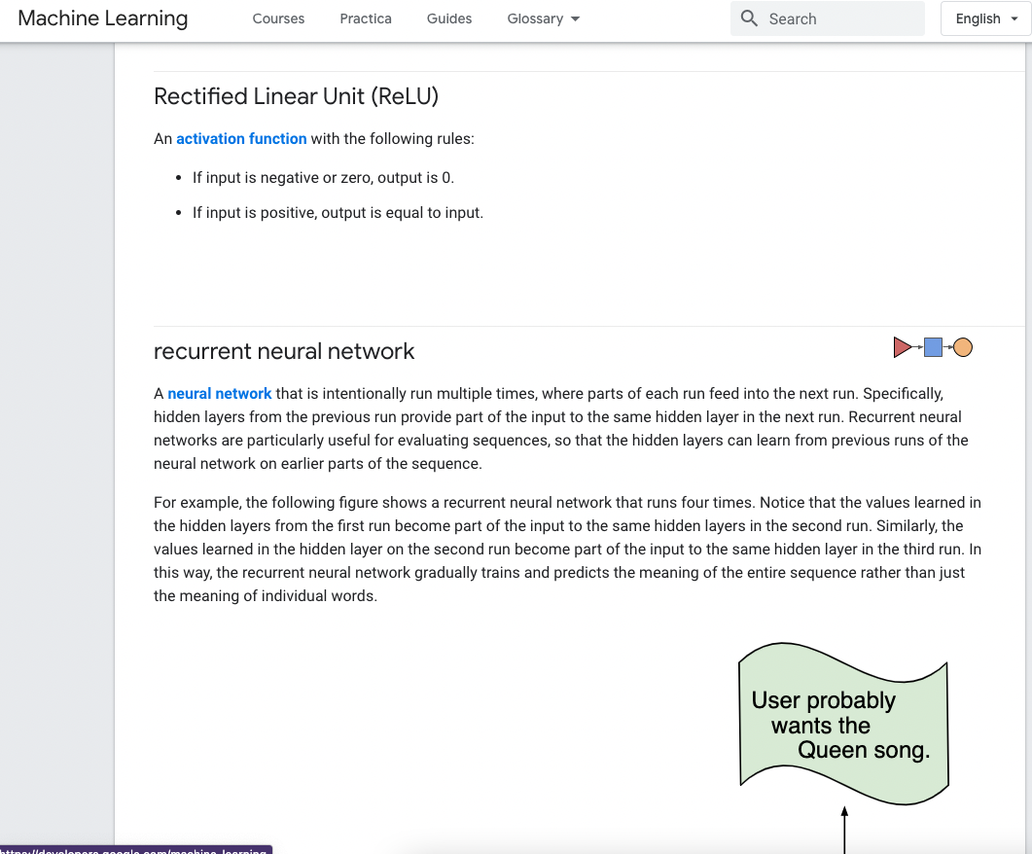
ESTABLISH JARGON
MACHINE LEARNING DICTIONARY
412 words and phrases scraped from Google Developers’ Machine Learning Glossary
From ”A/B testing” to “wide model”

Slide 7
CREATE CORPUS
Gather 3,151 abstracts
Query machine learning PubMed IDs using pmidcite library and NCBI API
“machine learning” in abstract or title
from peer-reviewed, English-language journals
publication date range: 2010 -2020
Scrape* corresponding abstracts, titles, publication dates, and citation counts using the requests library and BeautifulSoup
*legally
Notes:
NCBI: National Center for Biotechnology Information

Slide 8
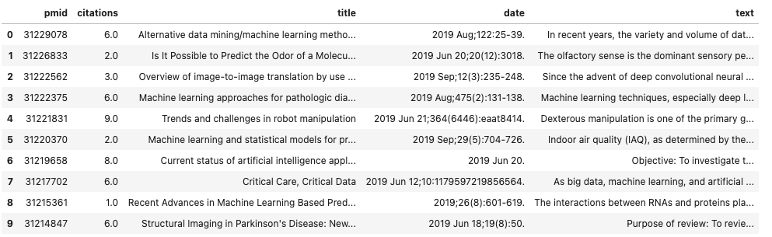
CLEANING
Text and title were cleaned during scraping
Month and Year extracted from ‘date’ post-scrape
Dropped any rows with missing data → 2,986 remaining
Text and title were cleaned during scraping
Month and Year extracted from ‘date’ post-scrape
Dropped any rows with missing data

Slide 9
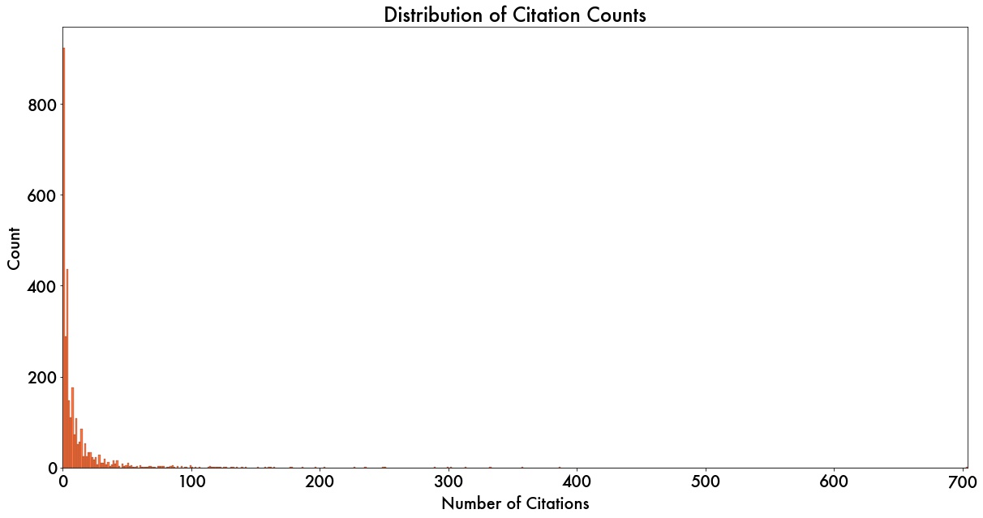
DATA EXPLORATION
‘citations’ distribution very right-skewed (skew = 9.1); several outliers
range: (0, 704)
Text and title were cleaned during scraping
Month and Year extracted from ‘date’ post-scrape
Dropped any rows with missing data
Notes:
Log-transform would remove ’0’ citations

Slide 10
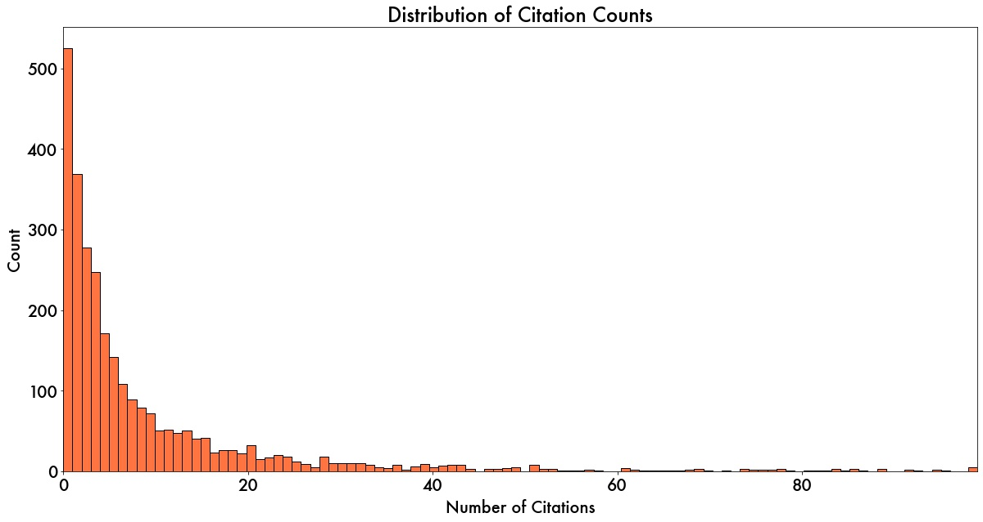
DATA EXPLORATION
Removed outliers (skew = 3.26)
2,809 rows remain
citations range : (0, 99)
Explored correlations between citations &:
Time since publication
Length of title
Length of abstract
Text and title were cleaned during scraping
Month and Year extracted from ‘date’ post-scrape
Dropped any rows with missing data
Notes:
Weak positive correlation (0.32) between days live and citations, which makes sense. Will keep in mind.

Slide 11
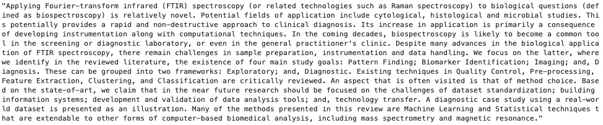
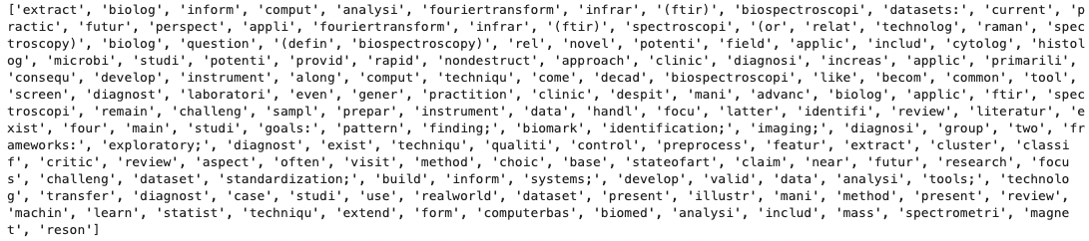
TEXT PREPROCESSING
Combine title & abstract
Remove special chars & punctuation
Lowercase
Remove English stopwords
Stemming? Two versions:
None: jargon analysis
PorterStemmer: standard frequency analysis
Notes:
Tested lemmatizing and stemming; went with stemming and then

Slide 12
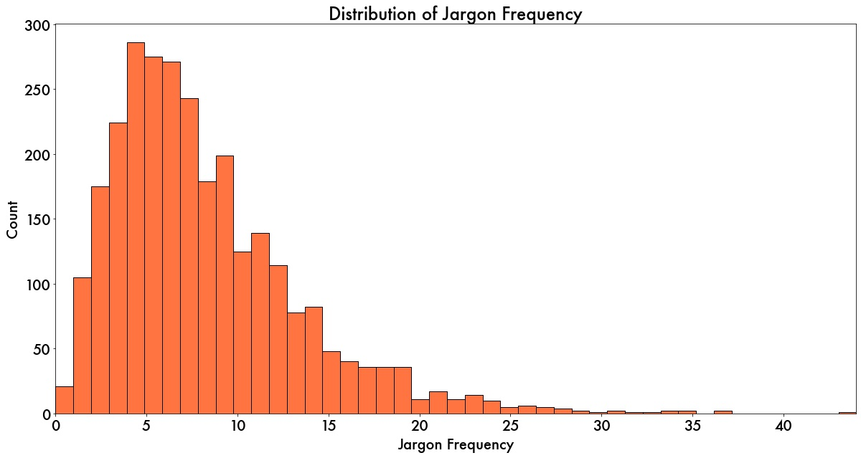
JARGON ANALYSIS
Constructed sparse matrix of jargon vectors for each document
Total jargon frequency
Individual jargon term frequency
Text and title were cleaned during scraping
Month and Year extracted from ‘date’ post-scrape
Dropped any rows with missing data

Slide 13
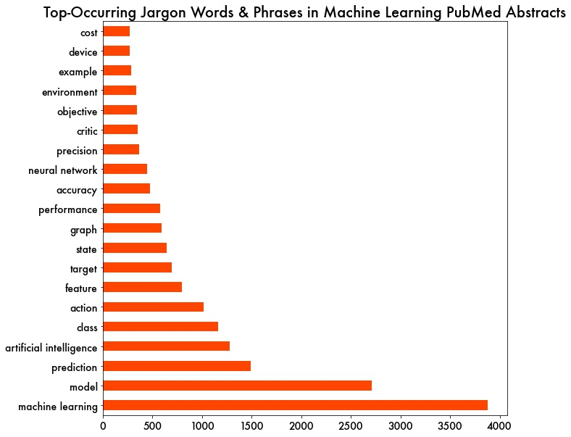
JARGON ANALYSIS
Constructed sparse matrix of jargon vectors for each document
Total jargon frequency
Individual jargon term frequency
Text and title were cleaned during scraping
Month and Year extracted from ‘date’ post-scrape
Dropped any rows with missing data

Slide 14
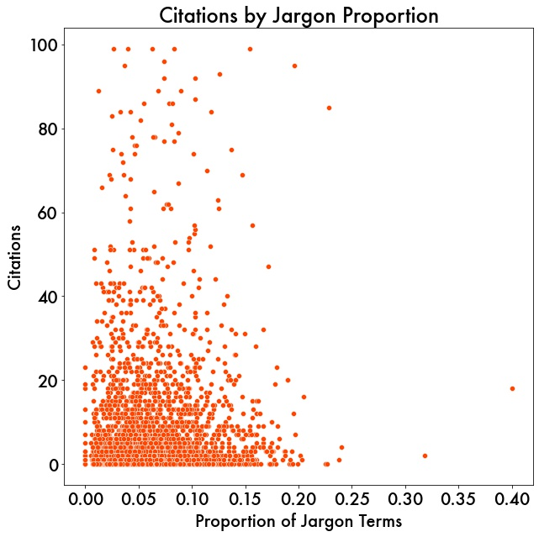
JARGON ANALYSIS
No correlation between number of citations and proportion of jargon
r = .03, p = .08
Failure to replicate Martinez & Mammola findings.
Notes:
Although I wasn’t able to replicate the primary finding, I explored other aspects.

Slide 15
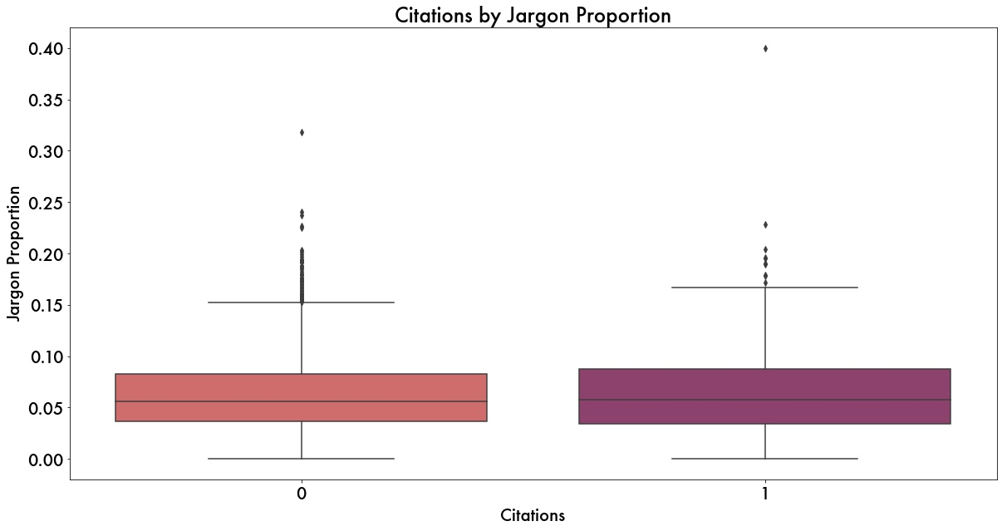
JARGON ANALYSIS
Jargon frequency?
No correlation between # citations and jargon count (r = 0.03, p=.15)
Specific jargon terms?
Regression analyses showed jargon terms have no predictive power.
Classification model?
Created “highly cited” class
Citations > 10 (mean + 1 sd)
Models never above baseline accuracy
Notes:
Completely overlapping
Also attempted to model standard vectorized representations of the documents – none of the words had any predictive relationship with the citations

Slide 16
PART I CONCLUSIONS
FAILURE TO REPLICATE
Neither jargon proportion, nor jargon frequency, nor specific jargon terms were found to be predictive of the number of times that a paper was cited.
POSSIBLE LIMITATIONS
Insufficient data – limited by access
Journals spanned many disciplines
Notes:
One possibility is that this phenomenon does not hold true for machine learning, but there are at least a couple of limitations that I identified which could be contributing to the result.
insufficient data – we had around 3K abstracts – the original study used 7 times as many
Second – journals spanned many disciplines – simply because any one journal that I was able to access wouldn’t give me a sufficient number of documments. And it wasn’t machine learning specifically.
I set out to address these in the second phase of the project, which we’ll head next.

Slide 17
PART II: TOWARDS DATA SCIENCE
Establish a machine learning ‘jargon’ dictionary ☑️
Develop a corpus of posts from Medium’s Toward Data Science blog that reference ’machine learning’
Calculate proportion of jargon words in each post
Does using more jargon lead to fewer citations?
Establish appropriate (available) metric
Notes:
Specifically, let’s head towards data science!
In an effort to address the two limitations I just identified, I turned to Medium’s towards data science blog.
-Lots more content (no rigorous peer-review process), and generally, more focused in terms of discipline
For this phase, step one was already taken care of
But we don’t have the metric of citations -

Slide 18
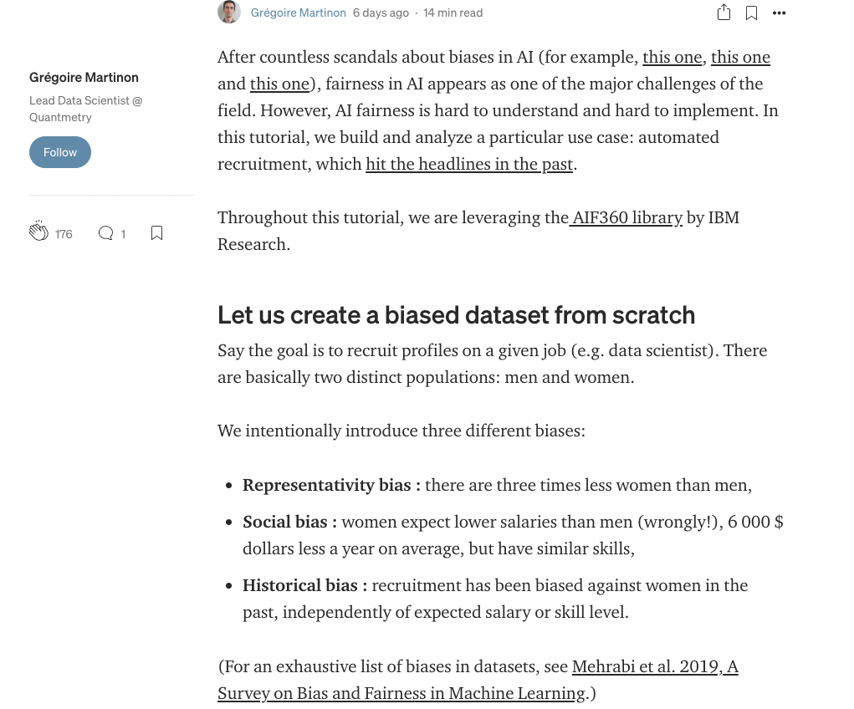
ESTABLISH PROXY METRIC
CLAPS
"Clapping is a way readers can show appreciation for a Medium story and recommend it to their followers."
The more you like something, the more you can clap (up to 50X per post).
Clapping plays a role in determining how much authors can earn per story.
Source: Medium.com

Slide 19
CREATE CORPUS
Gather 9,804 posts
Query posts from Towards Data Science blog
Scrape* date, title, subtitle, section titles, paragraph text, and number of claps from each post using the requests library and BeautifulSoup
*legally
Notes:
NCBI: National Center for Biotechnology Information

Slide 20
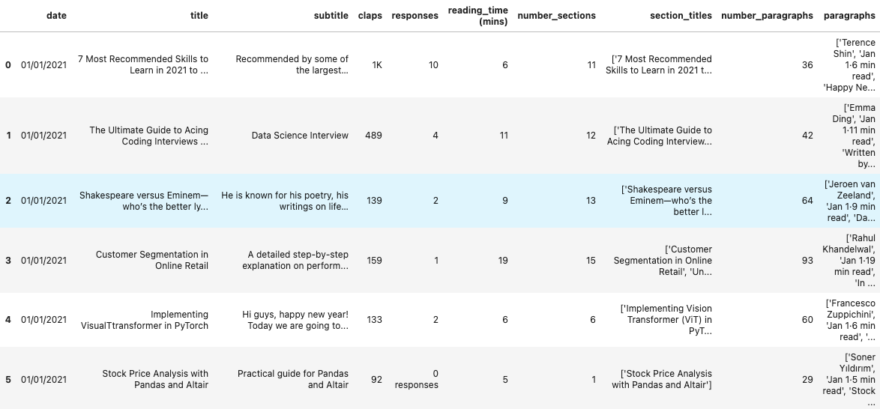
CLEANING
Text and title were cleaned during scraping
Month and Year extracted from ‘date’ post-scrape
Dropped any rows with missing data
Converted ‘claps’ and ‘responses’ to int
No missing data

Slide 21
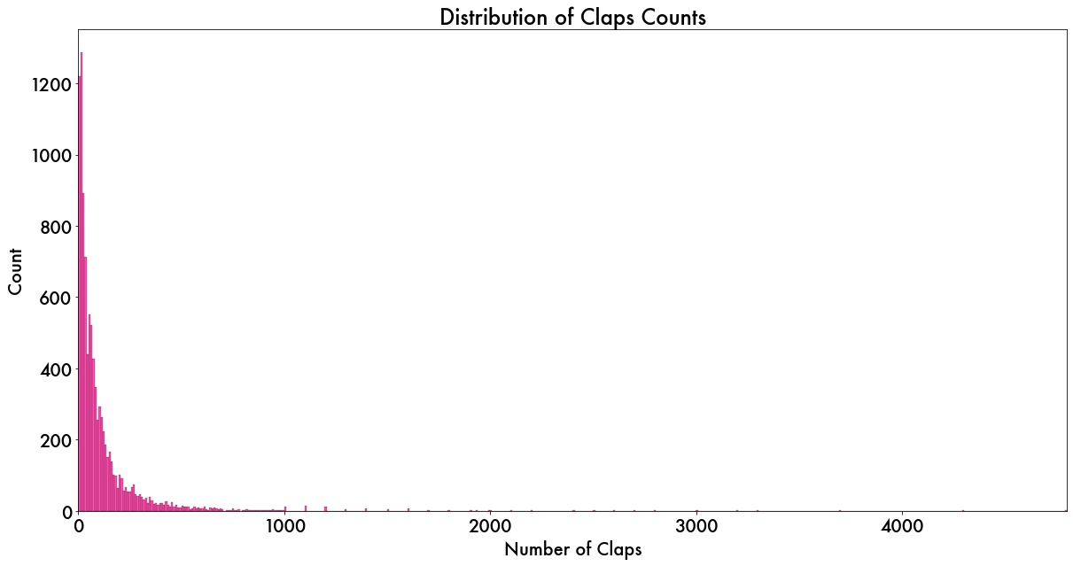
DATA EXPLORATION
‘claps’ distribution very right-skewed (skew = 7.73); several outliers
range: (0, 4,800)
Text and title were cleaned during scraping
Month and Year extracted from ‘date’ post-scrape
Dropped any rows with missing data
Notes:
Log-transform would remove ’0’ citations

Slide 22
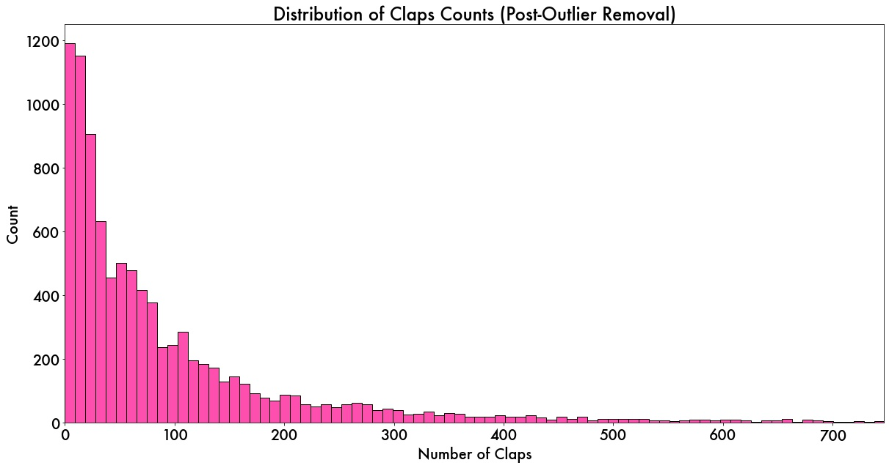
DATA EXPLORATION
Removed outliers (skew = 2.41)
9,290 posts remain
claps range : (0, 747)
Explored correlations between claps &:
Days live
Length of post
Text and title were cleaned during scraping
Month and Year extracted from ‘date’ post-scrape
Dropped any rows with missing data
Notes:
No significant correlations to account for

Slide 23
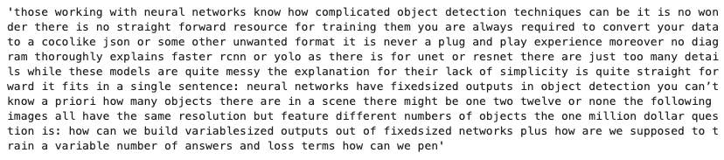
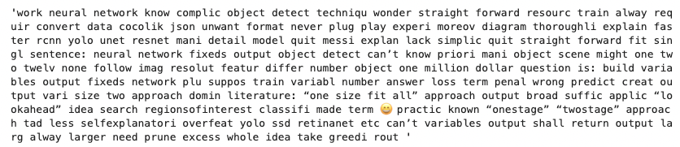
TEXT PREPROCESSING
Combine text fields
Remove special chars & punctuation
Lowercase
Remove English stopwords
Stemming? Two versions:
None: jargon analysis
PorterStemmer: standard frequency analysis
First 1,000 characters of a sample post
Post-preprocessing
Notes:
Very similar

Slide 24
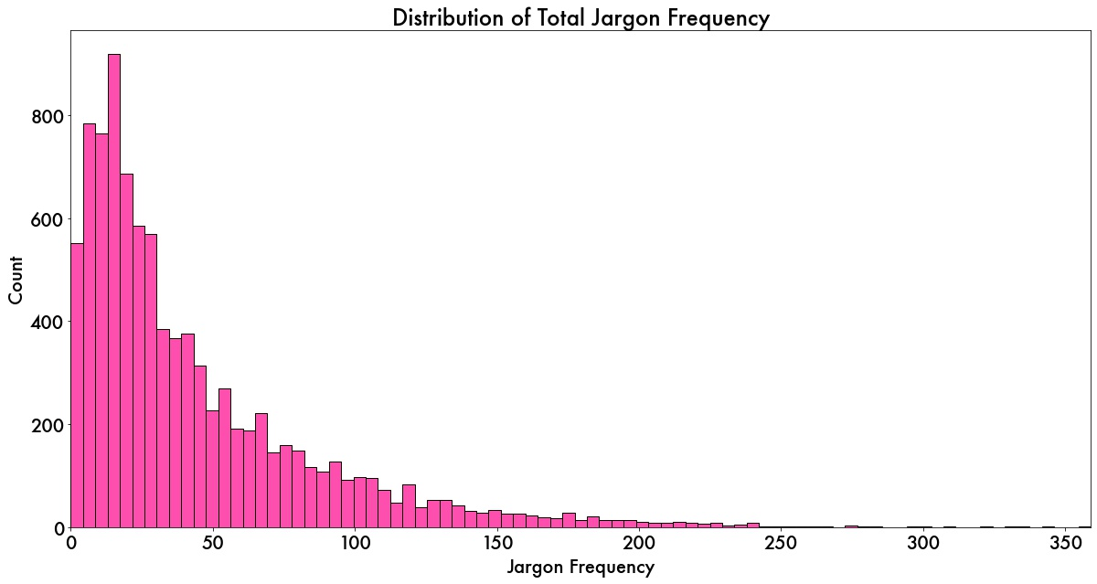
JARGON ANALYSIS
Constructed sparse matrix of jargon vectors for each document
Total jargon frequency
Individual jargon term frequency
Text and title were cleaned during scraping
Month and Year extracted from ‘date’ post-scrape
Dropped any rows with missing data
Notes:
Log-transform would remove ’0’ citations

Slide 25
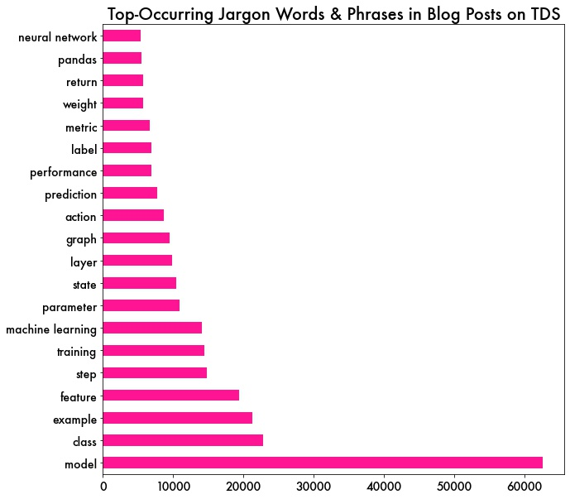
JARGON ANALYSIS
Constructed sparse matrix of jargon vectors for each document
Total jargon frequency
Individual jargon term frequency
Text and title were cleaned during scraping
Month and Year extracted from ‘date’ post-scrape
Dropped any rows with missing data
Notes:
Log-transform would remove ’0’ citations

Slide 26
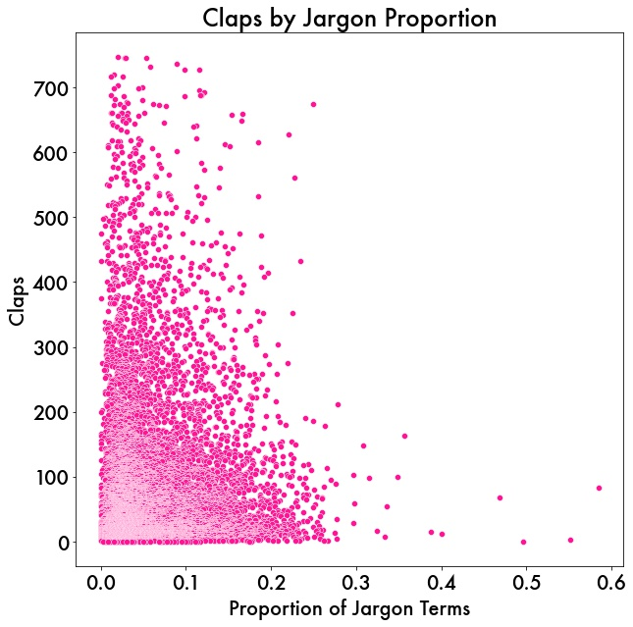
JARGON ANALYSIS
Extremely weak negative correlation between number of claps and proportion of jargon
r = -.02, p = .03
Subsequent regression analysis confirmed that the proportion of jargon accounted for practically none of the variance in ‘claps’
Notes:
There’s not a lot of there there…..

Slide 27
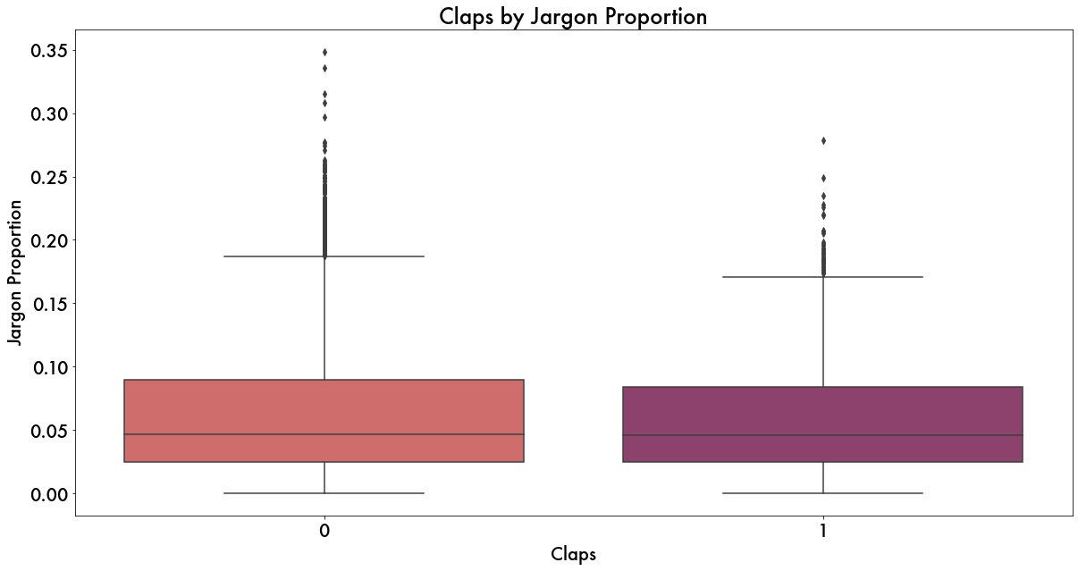
JARGON ANALYSIS
Jargon frequency?
No correlation between # claps and jargon count (r = 0.02, p=.06)
Specific jargon terms?
Regression analyses showed jargon terms have no predictive power.
Classification model?
Created “many claps” class
Claps > 208 (mean + 1 sd)
Models never above baseline accuracy
Notes:
Completely overlapping
Also attempted to model standard vectorized representations of the documents – none of the words had any predictive relationship with the citations

Slide 28
PART II CONCLUSIONS
FAILURE TO REPLICATE (X 2!)
Neither jargon proportion, nor jargon frequency, nor specific jargon terms were found to be predictive of the number of claps received by a Towards Data Science post.
POSSIBLE LIMITATIONS
Perhaps the jargon isn’t the right jargon
‘Claps’ are perhaps not the ideal metric
Notes:
One possibility is that this phenomenon does not hold true for machine learning, but there are

Slide 29
FUTURE DIRECTIONS
JARGON ANALYSIS:
Develop a custom jargon dictionary
PubMed Papers:
Gain access to a machine learning journal
Within a specific discipline (i.e. cancer detection), does the phrase ‘machine learning’ (or ‘deep learning’) affect number of citations?
If so, how does that effect change over time?
Towards Data Science Posts:
Gain access and explore other engagement metrics, like pageviews or referral links
Notes:
-perhaps the out-of-the-box Google version isn’t “jargony” enough

Slide 30
PART III:
TOPIC MODELING
Unsupervised learning technique
Probabilistic model that discovers the abstract “topics” in a collection of documents.
Using contextual clues, topic models can connect words with similar meanings and distinguish between uses of words with multiple meanings
Identify, then classify.
Is there a specific topic that gets more ‘claps’ on Towards Data Science?
Source: MALLET site
Notes:
So, all of this failing to reject the null hypothesis was leaving ME feeling a little rejected.
So I turned to my good friend unsupervised learning - specifically, topic modeling.
A "topic" consists of a cluster of words that frequently occur together
At this point, it was clear that I wasn’t finding a relationship between jargon and reach. And in fact, I had ruled out the use of any specific words as predictive. But perhaps I was thinking too granular – word frequency models reveal little in the way of inter- or intradocument statistical structure
Perhaps there’s a relationship at a higher level; specifically topics.
Identify the topic or topics present in a document and classify accordingly.
Then we can ask questions about groups of documents that have the same topic classification
I performed this analysis for both datasets, but in the interest of time and news you can use, I’ll share my findings for the Towards Data Science corpus.
CLICK – is there a specific topic that you can write about that will get you more claps on TDS?

Slide 31
TOPIC MODELING APPROACH
LDA (Latent Dirichlet Allocation)*
Generative probabilistic model that represents documents as mixtures of topics
Implement in python with Gensim, Spacy, and pyLDAvis libraries
Plus a Gensim wrapper for MALLET (MAchine Learning for LanguagE Toolkit) LDA topic modeling, which uses Gibbs sampling – an MCMC algorithm!
Determine topics present in corpus and dominant topic in each document
*Source: Journal of Machine Learning Research
Notes:
Topic modeling programs do not know anything about the meaning of the words in a text. Instead, they assume that any piece of text is composed (by an author) by selecting words from possible baskets of words where each basket corresponds to a topic. If that is true, then it becomes possible to mathematically decompose a text into the probable baskets from whence the words first came. The tool goes through this process over and over again until it settles on the most likely distribution of words into baskets, which we call topics.
LDA is a special instantiation of topic modeling, and by far the most popular

Slide 32
WHAT DOES A TOPIC LOOK LIKE?
Collection of keywords:
probability, distribution, state, function, sample, number, algorithm, give, problem, time
word, text, model, language, topic, document, article, sentence, nlp, search
data, database, system, service, cloud, process, pipeline, tool, query, store
Notes:
Generates topics, and a percentage contribution
Here are three topics generated by one of my topic models
But how many topics? And which oens are right? ANSWER: THAT DEPENDS

Slide 33
TOPIC MODEL SELECTION
Key Hyperparameters
Bigrams vs Trigrams
Number of Topics
Selection criteria
Metrics
Coherence vs Perplexity
Human judgment
Qualitative evaluation of topic keywords
Qualitative visual evaluation of topic spread/overlap
Notes:
Lots of decision to make here
Hyperparameters – chosen a posteriori
Following experimentation
Coherence vs perplexity
Coherence
Recent studies have "shown that predictive likelihood (or equivalently, perplexity) and human judgment are often not correlated, and even sometimes slightly anti-correlated."source
To put it plainly - optimizing for perplexity will not optimize for human interpretability, so in keeping with the spirit of this investigation, I will focus on coherence score to evaluate topic quality.
Qualitative evaluations dependent upon use case
This will hopefully all make a little more sense once we can visualize

Slide 34
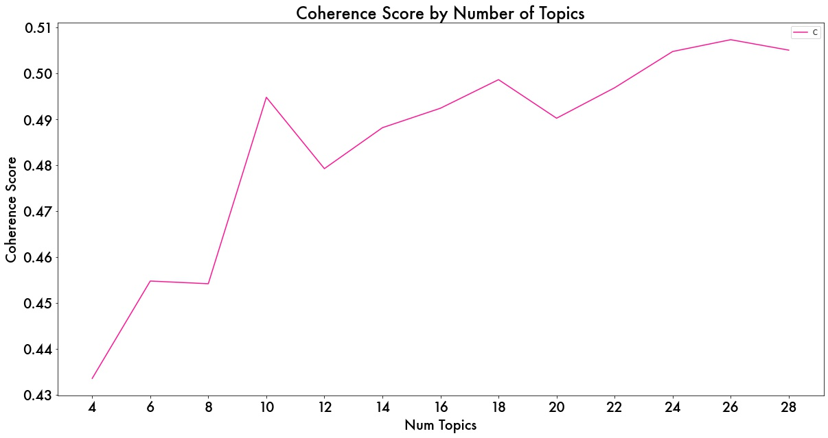
COHERENCE SCORE
Text and title were cleaned during scraping
Month and Year extracted from ‘date’ post-scrape
Dropped any rows with missing data
Peaking at 26 topics, followed by 24, with 18 and 10 close behind.
Notes:
You can see it’s a pretty tight range of coherence, so I’m able to focus on some of the more qualitative measures without sacrificing too much
This is a probabilistic model, so you will get different results each time.

Slide 35
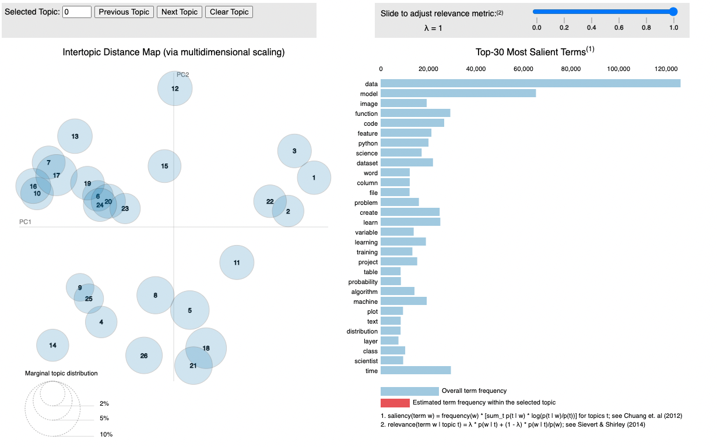
TOPIC MODEL: 26 TOPICS
Coherence score: 0.507
Good distribution
Too much overlap
Text and title were cleaned during scraping
Month and Year extracted from ‘date’ post-scrape
Dropped any rows with missing data
Notes:
The larger the bubble, the more frequent is the topic in the documents.
Distance between the topics is an approximation of semantic relationship between the topics.
A good topic model will have big and non-overlapping bubbles scattered throughout the chart.

Slide 36
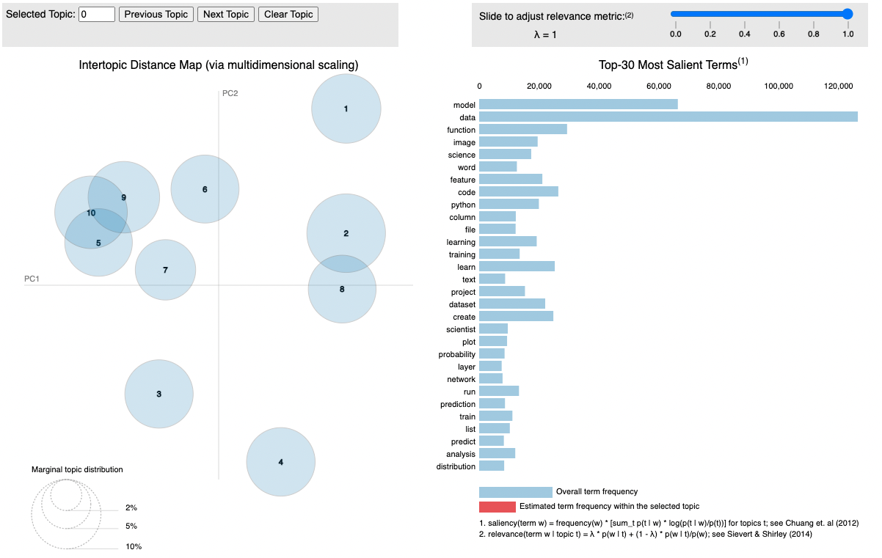
TOPIC MODEL: 10 TOPICS
Coherence score: 0.495
This model provides the best balance of spread, disambiguation, and coherence score.
Text and title were cleaned during scraping
Month and Year extracted from ‘date’ post-scrape
Dropped any rows with missing data
Notes:
Blue bars represent the overall frequency of each word in the corpus. If no topic is selected, the blue bars of the most frequently used words will be displayed.
Red bars give the estimated number of times a given term was generated by a given topic. The word with the longest red bar is the word that is used the most by the posts belonging to that topic.

Slide 37
10-TOPIC KEYWORDS
ai, game, system, people, human, world, team, player, make, decision | data, science, learn, work, scientist, project, machine, good, time, question | function, column, python, data, code, list, method, create, table, type | code, file, create, run, python, project, follow, package, app, api | image, model, network, layer, training, learning, input, deep, learn, train
data, plot, analysis, time, show, cluster, visualization, number, dataset, customer | word, text, model, language, topic, document, article, sentence, nlp, search | data, database, system, service, cloud, process, pipeline, tool, query, store | probability, distribution, state, function, sample, number, algorithm, give, problem, time | model, data, feature, dataset, prediction, machine, predict, set, learning, test
Text and title were cleaned during scraping
Month and Year extracted from ‘date’ post-scrape
Dropped any rows with missing data
Notes:
What can we do with these?
Can MOST REPRESENTATIVE DOCUMENT FOR EACH TOPIC, or find the dominant topic for each document – what is it MOSTLY about

Slide 38
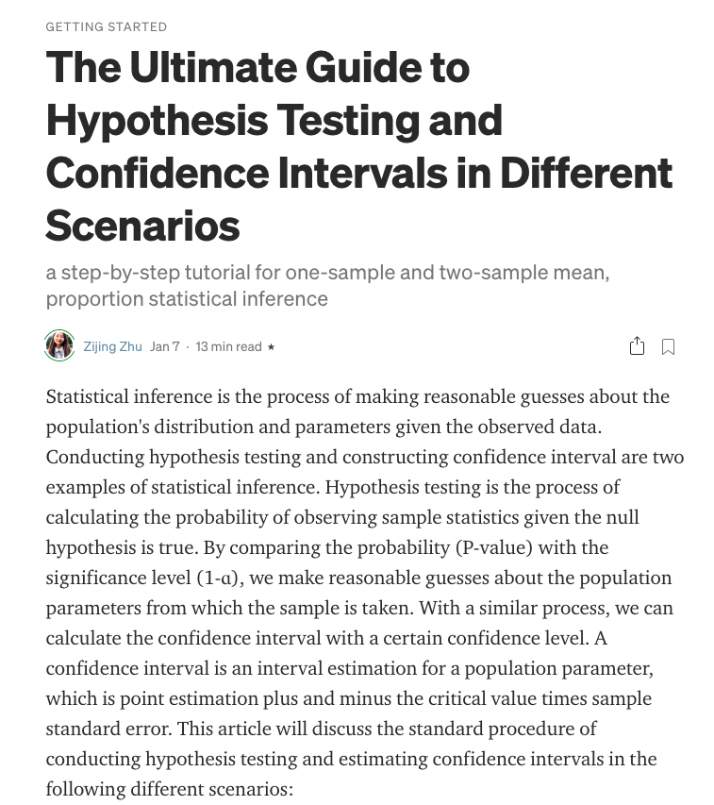
APPLY TOPIC MODEL TO DOCUMENTS
FIND DOMINANT TOPIC FOR EACH DOCUMENT
Topic 8:
probability, distribution, state, function, sample, number, algorithm, give, problem, time
0.87 percent contribution

Slide 39
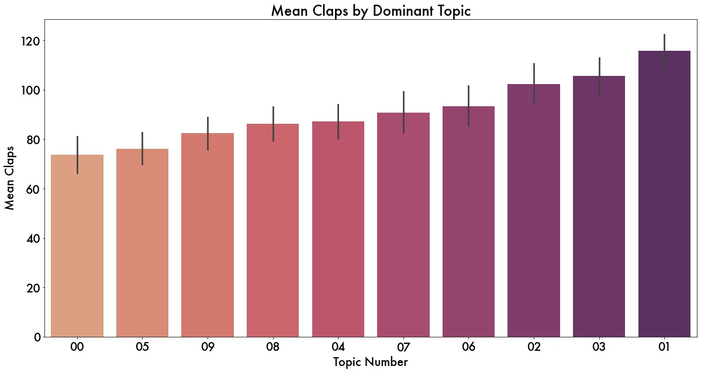
IS THERE A TOPIC THAT GETS MORE ‘CLAPS’?
115.8 clap mean (Topic 1):
model, data, feature, dataset, prediction, machine, predict, set, learning, test
73.8 clap mean (Topic 0)
data, database, system, service, cloud, process, pipeline, tool, query, store
But topic accounts for almost none of the variance in claps (R2 = 0.013).
Notes:
And then we can create a supervised learning problem – apply the topics to ask a question about our target variable claps

Slide 40
PART III: CONCLUSIONS & FUTURE DIRECTIONS
POST TOPIC IS NOT PREDICTIVE OF CLAPS
Your post about
FUTURE DIRECTIONS
Revisit with b
KEY TAKEAWAY
Revisit with b
Notes:
One possibility is that this phenomenon does not hold true for machine learning, but there are

Slide 41
THANKS!
Acknowledgements:
With much gratitude to Chuck, Varun, & Grant for your knowledge, guidance, & support.
Special thanks to DSIR-2221E for your educational, entertaining, and overall excellent company on this journey!

Slide 42
CREDITS
Special thanks to all the people who made and released these awesome resources for free:
Presentation template by SlidesCarnival
Photographs by Unsplash

Slide 43
CITATIONS
Martínez, Alejandro; Mammola, Stefano (2021): Supplementary material from "Specialized terminology reduces the number of citations to scientific papers". The Royal Society. Collection. https://doi.org/10.6084/m9.figshare.c.5356446.v1

